Slide 1
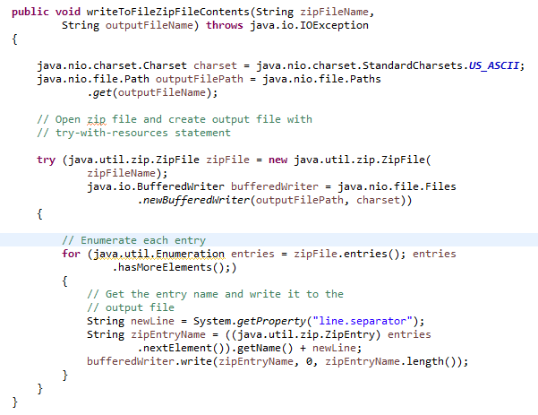
The try-with-resources Statement
In this example, the try-with-resources statement contains two declarations that are separated by a semicolon: ZipFile and BufferedWriter. When the block of code that directly follows it terminates, either normally or because of an exception, the close methods of the BufferedWriter and ZipFile objects are automatically called in this order. Note that the close methods of resources are called in the opposite order of their creation.

